Slide 1
Oracle Objects
Dr.U.K.Sridevi
Department of Applied Mathematics and Computational Sciences

Slide 2
Oracle Object
Oracle object types are user-defined types that make it possible to model real-world entities
Customers and purchase orders stored as objects in the database
Oracle Database implements the object-type model as an extension of the relational model

Slide 3
Advantages of Objects
Objects Can Encapsulate Operations Along with Data
Objects Are Efficient
Objects Can Represent Part-Whole Relationships

Slide 4
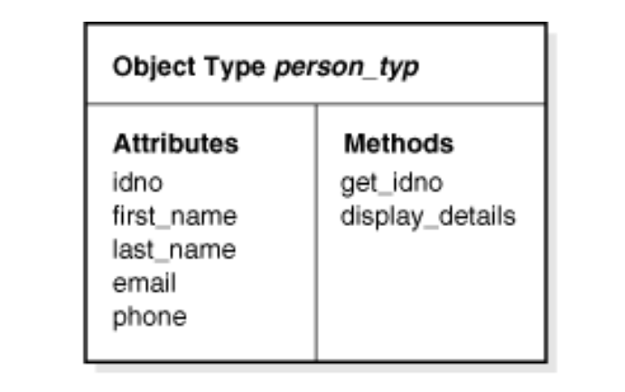

Slide 5
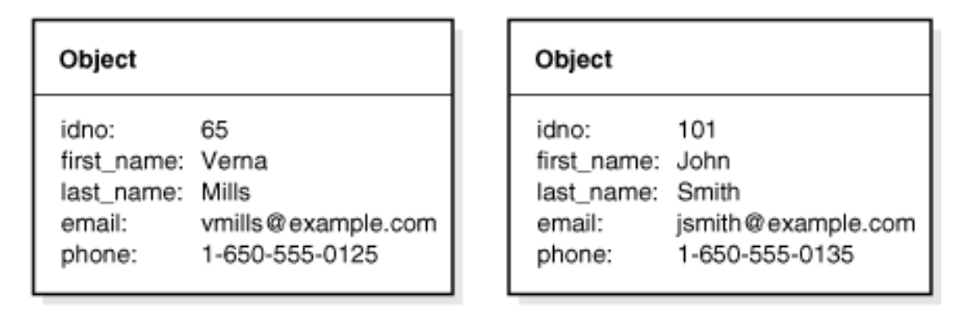

Slide 6
CREATE TABLE contacts ( contact person_typ, contact_date DATE );
INSERT INTO contacts VALUES ( person_typ (65, 'Verna', 'Mills', 'vmills@example.com', '1-650-555-0125'), '24 Jun 2003' );
SELECT c.contact.get_idno() FROM contacts c;

Slide 7
Create Type
CREATE TYPE person_typ AS OBJECT ( idno NUMBER, first_name VARCHAR2(20), last_name VARCHAR2(25), email VARCHAR2(25), phone VARCHAR2(20), MAP MEMBER FUNCTION get_idno RETURN NUMBER, MEMBER PROCEDURE display_details ( SELF IN OUT NOCOPY person_typ )); /

Slide 8
CREATE TYPE BODY person_typ AS MAP MEMBER FUNCTION get_idno RETURN NUMBER IS BEGIN RETURN idno; END;
MEMBER PROCEDURE display_details ( SELF IN OUT NOCOPY person_typ ) IS BEGIN -- use the PUT_LINE procedure of the DBMS_OUTPUT package to display details DBMS_OUTPUT.PUT_LINE(TO_CHAR(idno) || ' ' || first_name || ' ' || last_name); DBMS_OUTPUT.PUT_LINE(email || ' ' || phone); END; END; /

Slide 9
Create Table
CREATE TABLE person_obj_table OF person_typ;
INSERT INTO person_obj_table VALUES ( person_typ(101, 'John', 'Smith', 'jsmith@example.com', '1-650-555-0135') );
SELECT VALUE(p) FROM person_obj_table p WHERE p.last_name = 'Smith';

Slide 10
PL/SQL
DECLARE person person_typ;
BEGIN -- PL/SQL block for selecting a person and displaying details
SELECT VALUE(p) INTO person FROM person_obj_table p WHERE p.idno = 101; person.display_details();
END;
/

Slide 11
Using References to Row Objects
A REF is a logical pointer or reference to a row object that you can construct from an object identifier (OID).

Slide 12
CREATE TYPE emp_person_typ AS OBJECT ( name VARCHAR2(30), manager REF emp_person_typ ); /
CREATE TABLE emp_person_obj_table OF emp_person_typ; INSERT INTO emp_person_obj_table VALUES ( emp_person_typ ('John Smith', NULL)); INSERT INTO emp_person_obj_table SELECT emp_person_typ ('Bob Jones', REF(e)) FROM emp_person_obj_table e WHERE e.name = 'John Smith';

Slide 13
Case Study
A Country Bus Company owns a number of buses. Each bus is allocated to a particular route, although some routes may have several busses. Each route passes through a number of towns. One or more drivers are allocated to each stage of a route, which corresponds to a journey through some or all of the towns on a route. Some of the towns have a garage where busses are kept and each of the busses are identified by the registration number and can carry different numbers of passengers, since the vehicles vary in size and can be single or double-decked. Each route is identified by a route number and information is available on the average number of passengers carried per day for each route. Drivers have an employee number, name, address, and sometimes a telephone number. Produce relational schema for the following ER diagram

Slide 14
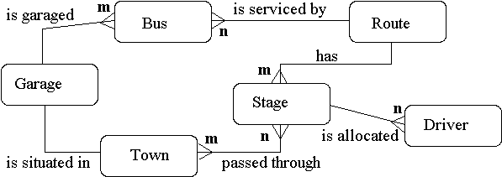

Slide 15
Object Types
https://docs.oracle.com/cd/B28359_01/appdev.111/b28371/adobjint.htm#CHDBCFAJ

